Slide 1

Deep Learning seminar
Sergi Bernet Andrés
Sergi.bernet@salle.url.edu
DS4DS – La Salle
07-11/03/22

Slide 2
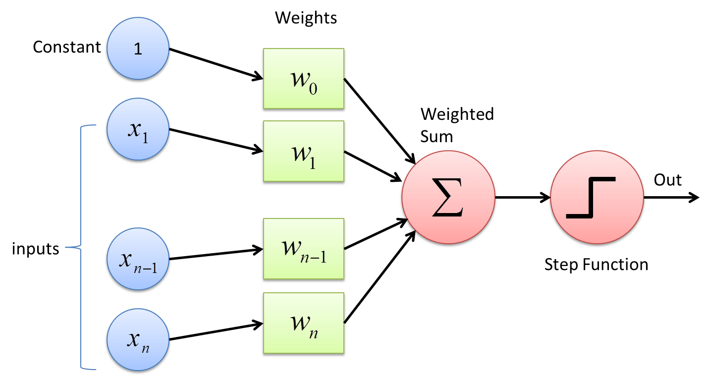
Backup – day 1
Perceptron as the basic neuron unit:
- Inputs
- Weights
- Activation function

Slide 3
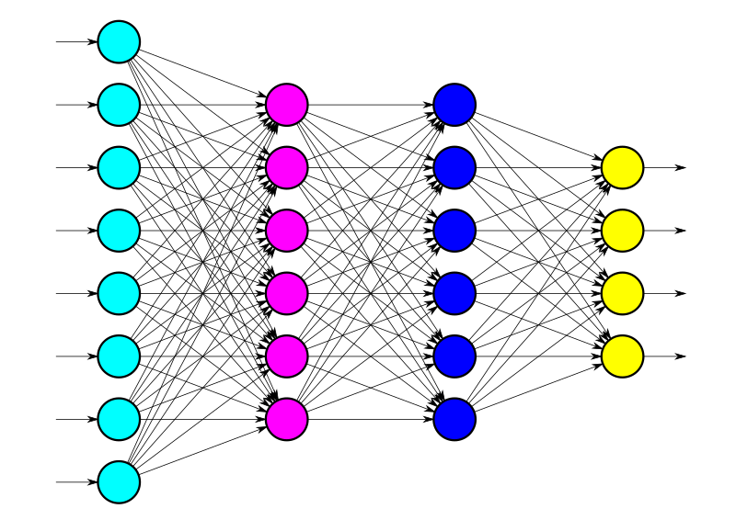
Backup – day 1
Perceptron as the basic neuron unit:
- Inputs
- Weights
- Activation function
Multi layer perceptron/Dense network as the evolution based on adding layers between our inputs and outputs.

Slide 4
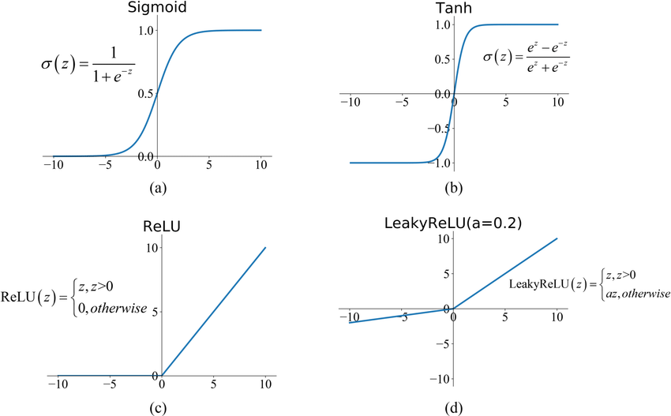
Backup – day 1
Activation functions in charge of the non-lineary of our models:
- ReLU or LeakyRelu in hidden layers.
- Careful with the selection for the output layer, depends directly on the problem we're solving!
- Objective feature: How many possible values?

Slide 5
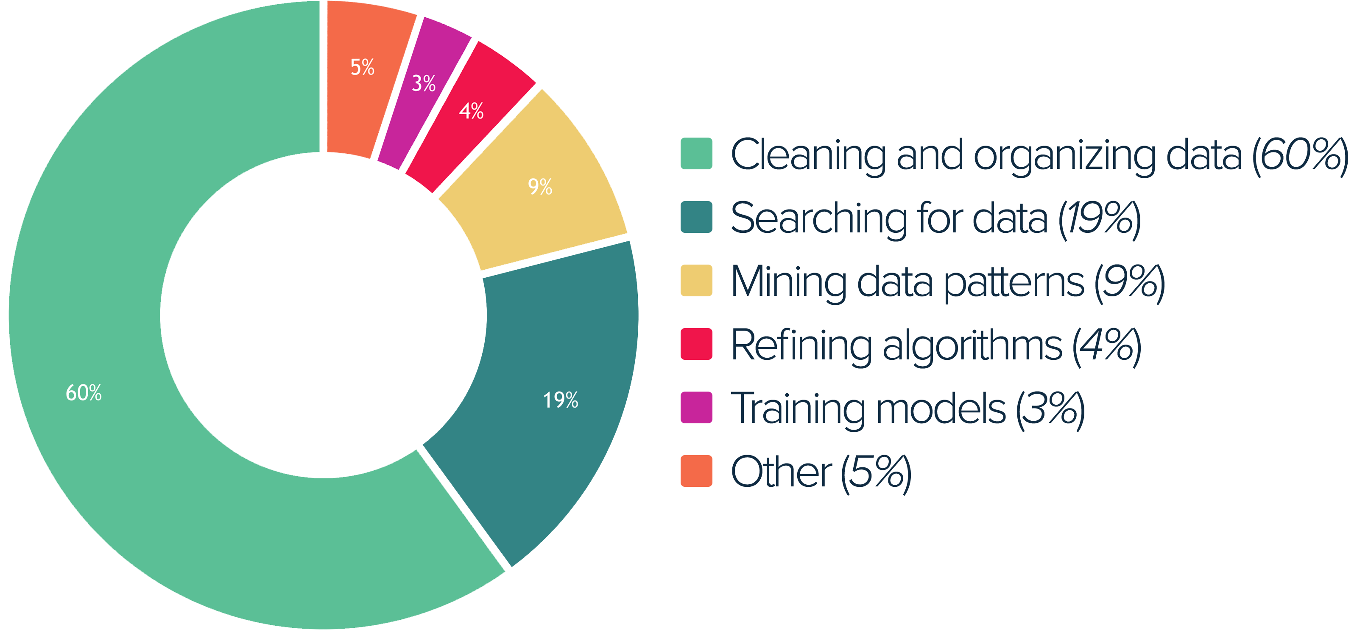
Backup – all days

Slide 6
Backup – all days
79%

Slide 7
Backup – day 2
Convolutions
1D: Between vectors and 1D kernel

Slide 8
Backup – day 2
0 | 3 | 5 | 7 | 6 | 5 | 8 | 12 | 15 | 14
Convolutions
1D: Between vectors and 1D kernel
- | - | - | 15 | 24 | 18
0 | 3 | 8 | 15 | 18 | 18

Slide 9
Backup – day 2
0 | 3 | 5 | 7 | 6 | 5 | 8 | 12 | 15 | 14
Convolutions
1D: Between vectors and 1D kernel
2D: Images and 2D (matrix) kernel
- | - | - | 15 | 24 | 18
0 | 3 | 8 | 15 | 18 | 18
-1 | 0 | 1
-2 | 0 | 2
-1 | 0 | 1
1 | 2 | 1
0 | 0 | 0
-1 | -2 | -1
Gx
Gy

Slide 10
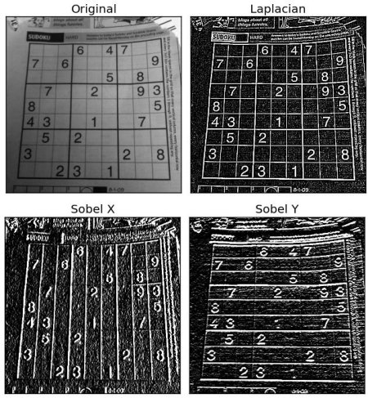
Backup – day 2
0 | 3 | 5 | 7 | 6 | 5 | 8 | 12 | 15 | 14
Convolutions
1D: Between vectors and 1D kernel
2D: Images and 2D (matrix) kernel
- | - | - | 15 | 24 | 18
0 | 3 | 8 | 15 | 18 | 18
-1 | 0 | 1
-2 | 0 | 2
-1 | 0 | 1
1 | 2 | 1
0 | 0 | 0
-1 | -2 | -1
Gx
Gy

Slide 11
Backup – day 2
0 | 3 | 5 | 7 | 6 | 5 | 8 | 12 | 15 | 14
Convolutions
1D: Between vectors and 1D kernel
2D: Images and 2D (matrix) kernel
- | - | - | 15 | 24 | 18
0 | 3 | 8 | 15 | 18 | 18
-1 | 0 | 1
-2 | 0 | 2
-1 | 0 | 1
1 | 2 | 1
0 | 0 | 0
-1 | -2 | -1
Gx
Gy

Slide 12

Backup – day 2
(32, 32, 3)
(30, 30, 8)
(26, 26, 16)
(24, 24, 64)
(12, ,12, 64)
(9216, )
(512)
(128)
(10)

Slide 13
Backup – day 2
(32, 32, 3)
(30, 30, 8)
(26, 26, 16)
(24, 24, 64)
(12, ,12, 64)
(9216, )
(512)
(128)
(10)

Slide 14
Backup – day 2
(32, 32, 3)
(30, 30, 8)
(26, 26, 16)
(24, 24, 64)
(12, ,12, 64)
(9216, )
(512)
(128)
(10)

Slide 15
Backup – day 2
(32, 32, 3)
(30, 30, 8)
(26, 26, 16)
(24, 24, 64)
(12, ,12, 64)
(9216, )
(512)
(128)
(10)

Slide 16
Backup – day 2
(32, 32, 3)
(30, 30, 8)
(26, 26, 16)
(24, 24, 64)
(12, ,12, 64)
(9216, )
(512)
(128)
(10)

Slide 17
Table of contents – Day 3
Sequences
What are sequences? How can we deal with them? What can we do?

Slide 18
Table of contents – Day 3
Sequences
Time series
LSTM networks
1D-CNN sequences
Hands-on

Slide 19
Sequences

Slide 20
Sequences
A set of related events, movements, or items that follow each other in a particular order from any type.

Slide 21
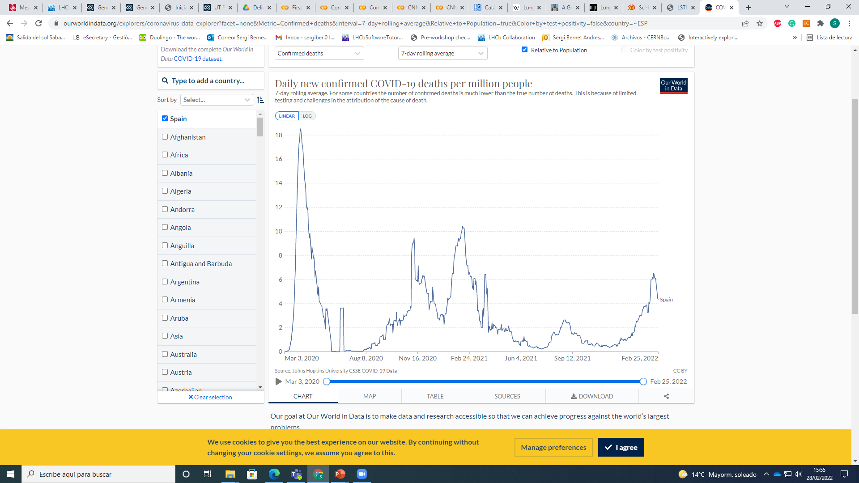
Sequences
A set of related events, movements, or items that follow each other in a particular order from any type.

Slide 22
Sequences
A set of related events, movements, or items that follow each other in a particular order from any type.

Slide 23
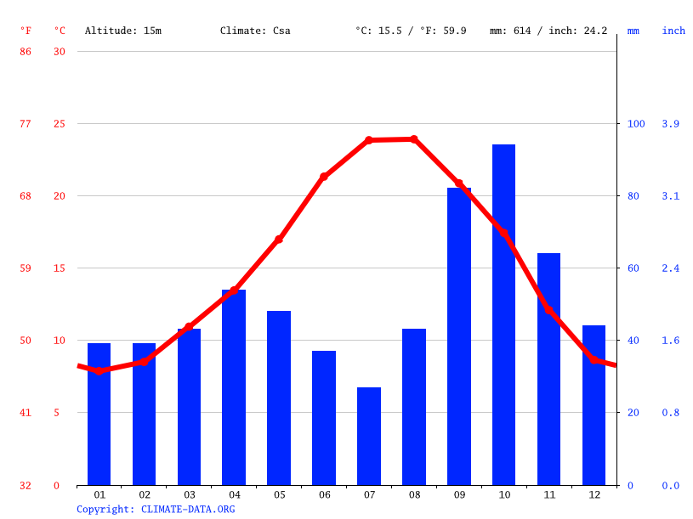
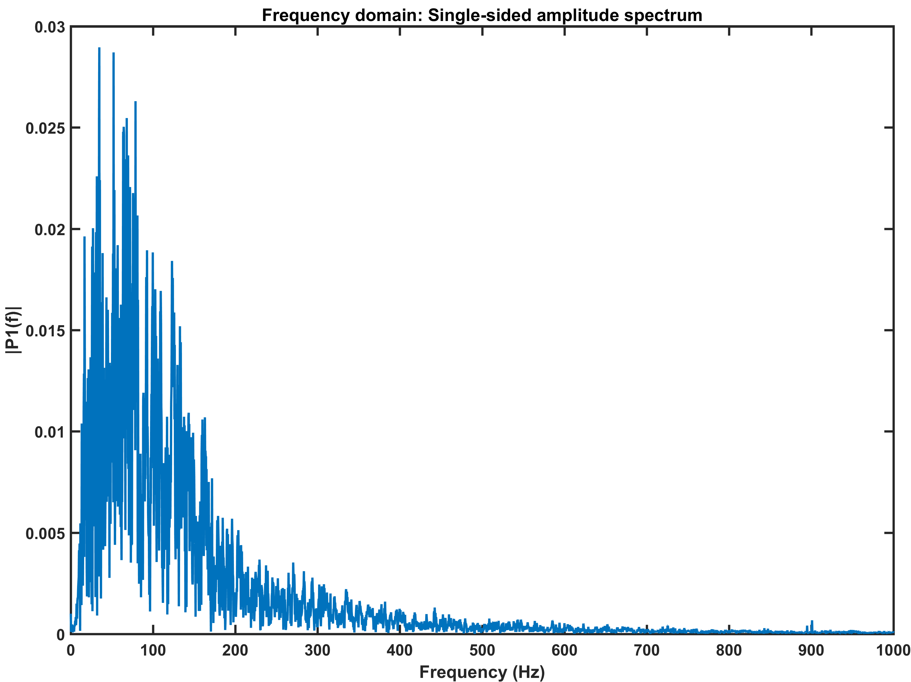
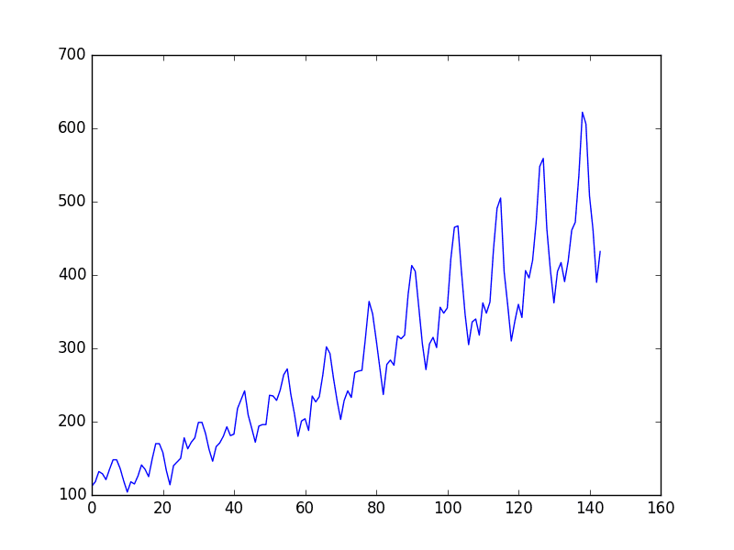
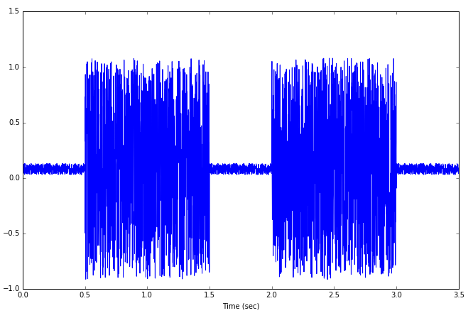
Sequences
Barcelona weather forecasting
Air passengers dataset
EMG

Slide 24
Sequences
A set of related events, movements, or items that follow each other in a particular order from any type.

Slide 25
Sequences
A set of related events, movements, or items that follow each other in a particular order from any type.

Slide 26
Sequences
A set of related events, movements, or items that follow each other in a particular order from any type.
“Mr. and Mrs. Dursley of number four, Privet Drive, were proud to say that they were perfectly normal, thank you very much.”

Slide 27
Sequences
A set of related events, movements, or items that follow each other in a particular order from any type.
“Mr. and Mrs. Dursley of number four, Privet Drive, were proud to say that they were perfectly normal, thank you very much.”
Harry Potter and the philosopher’s stone 1st phrase

Slide 28
Sequences
A set of related events, movements, or items that follow each other in a particular order from any type.

Slide 29
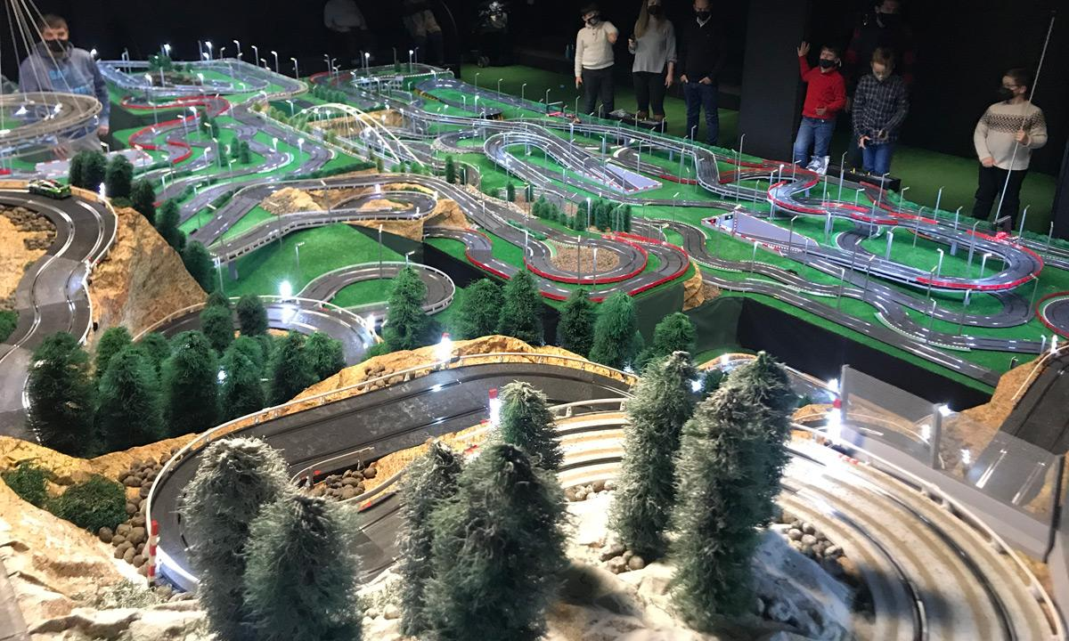
Sequences
A set of related events, movements, or items that follow each other in a particular order from any type.

Slide 30

Sequences
A set of related events, movements, or items that follow each other in a particular order from any type.

Slide 31
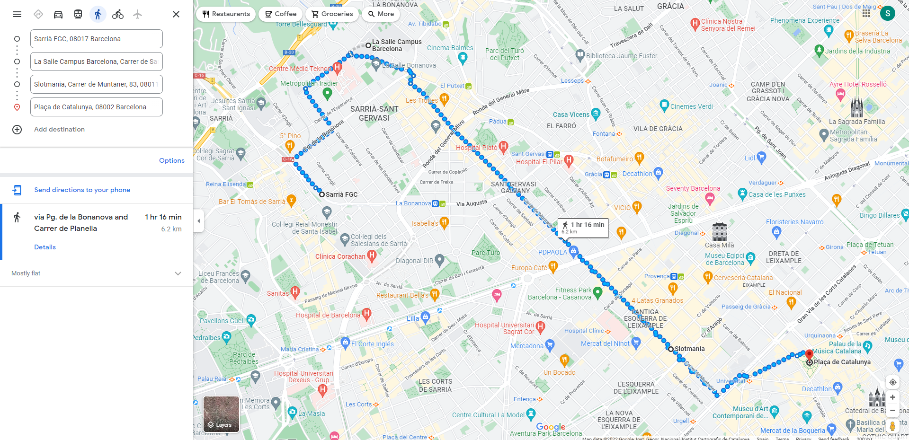
Sequences
A set of related events, movements, or items that follow each other in a particular order from any type.

Slide 32
Sequences
A set of related events, movements, or items that follow each other in a particular order from any type.

Slide 33
Sequences
A set of related events, movements, or items that follow each other in a particular order from any type.

Slide 34
Sequences
A set of related events, movements, or items that follow each other in a particular order from any type.

Slide 35
Sequences
A set of related events, movements, or items that follow each other in a particular order from any type.
(x, y)

Slide 36
Sequences
This type of data is useful in special for:
Finding patterns along the time.
Discover trends.
Outliers.
Forecast such as temperature (1D) position (3D) and more.
Music/text composition.
https://magenta.tensorflow.org/demos/web/

Slide 37
Time series forecasting

Slide 38
Traditional methods
Group of methodologies to perform forecasting. The most common ones are:
AR: Auto-regressive
MA: Moving Average
ARiMA: Both models together
Fourier (hooray)

Slide 39
Traditional methods – Auto-regressive
Time series model that depends linearly on previous time steps, using them as inputs to predict the value at the next time step.

Slide 40
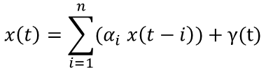
Traditional methods – Auto-regressive
Time series model that depends linearly on previous time steps, using them as inputs to predict the value at the next time step.
$$x\left(t\right)=\sum_{i=1}^{n}{(α_{i} x\left(t−i\right))}+γ(t)$$

Slide 41
Traditional methods – Auto-regressive
Time series model that depends linearly on previous time steps, using them as inputs to predict the value at the next time step.
$$x\left(t\right)=\sum_{i=1}^{n}{(α_{i} x\left(t−i\right))}+γ(t)$$
Time steps

Slide 42
Traditional methods – Auto-regressive
Time series model that depends linearly on previous time steps, using them as inputs to predict the value at the next time step.
$$x\left(t\right)=\sum_{i=1}^{n}{(α_{i} x\left(t−i\right))}+γ(t)$$
Time steps
Coefficient for each time step

Slide 43
Traditional methods – Auto-regressive
Time series model that depends linearly on previous time steps, using them as inputs to predict the value at the next time step.
$$x\left(t\right)=\sum_{i=1}^{n}{(α_{i} x\left(t−i\right))}+γ(t)$$
Time steps
Noise factor
Coefficient for each time step

Slide 44
Traditional methods – Auto-regressive
Time series model that depends linearly on previous time steps, using them as inputs to predict the value at the next time step.
$$x\left(t\right)=\sum_{i=1}^{n}{(α_{i} x\left(t−i\right))}+γ(t)$$
Time steps
Noise factor
Coefficient for each time step
$$x\left(t\right)= α_{1}x\left(t−1\right)+α_{2}x\left(t−2\right)+α_{3}x\left(t−3\right)…+α_{n}x\left(t−n\right)+γ(t)$$

Slide 45
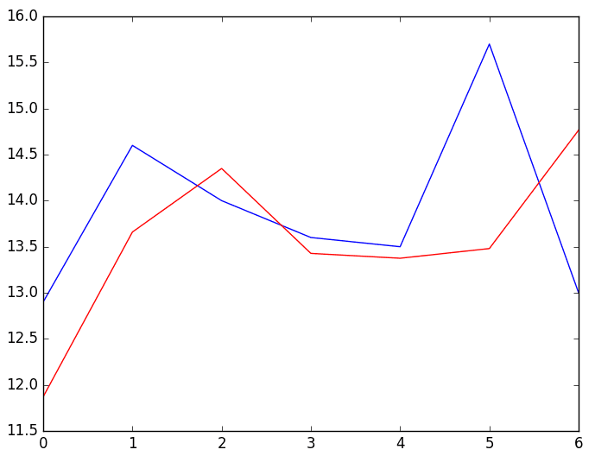
Traditional methods – Auto-regressive
Time series model that depends linearly on previous time steps, using them as inputs to predict the value at the next time step.
Autorregression example

Slide 46
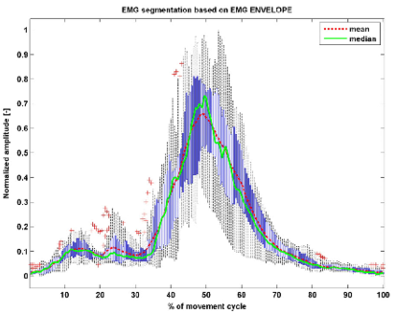
Traditional methods – Mean Average
Time series model that averages the time series data to capture the average change. Quite flexible model because is also useful for smoothing time series.
https://www.researchgate.net/figure/The-average-EMG-envelope-signal-in-the-movement-cycle-for-the-muscle-gastrocnemius-caput_fig4_261273556

Slide 47
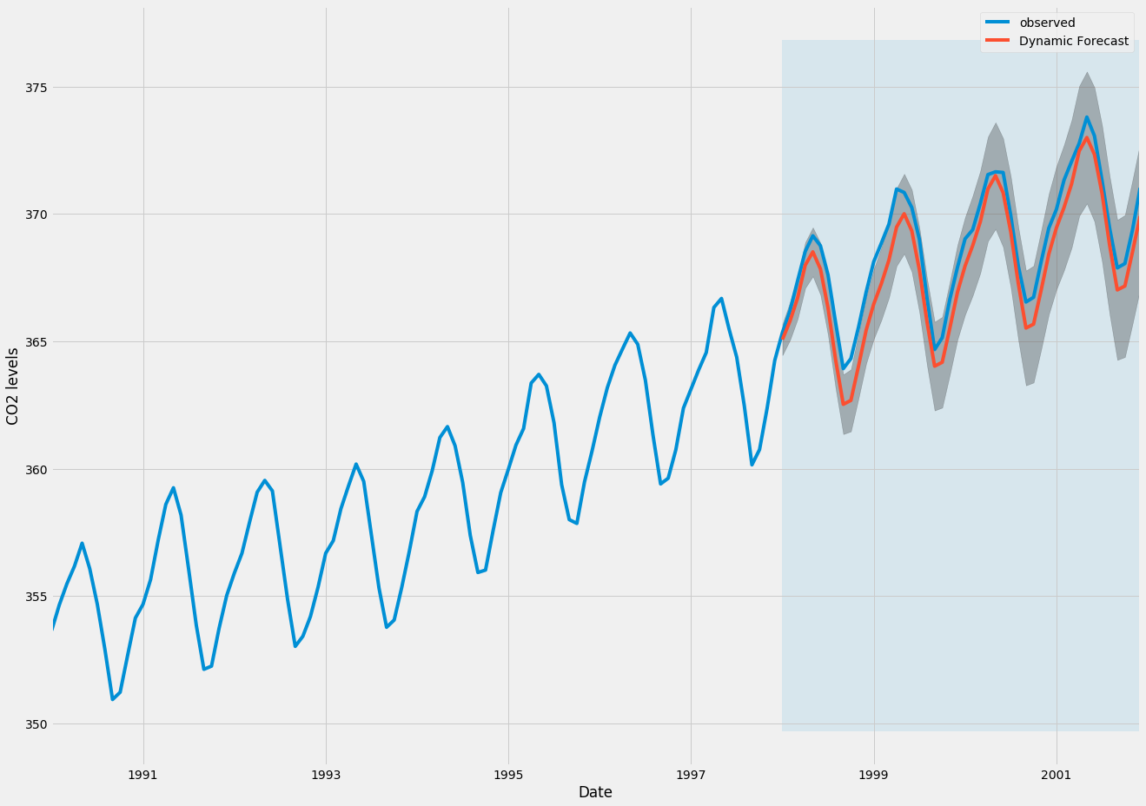
Traditional methods – ARiMA
Mixture of both, Auto-Regressive and Moving Average

Slide 48
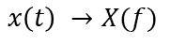
Traditional methods – Fourier
Decompose signals in frequency domain and describe our aiming function by the addition of several sines or cosines.
$$x\left(t\right) →X(f)$$

Slide 49
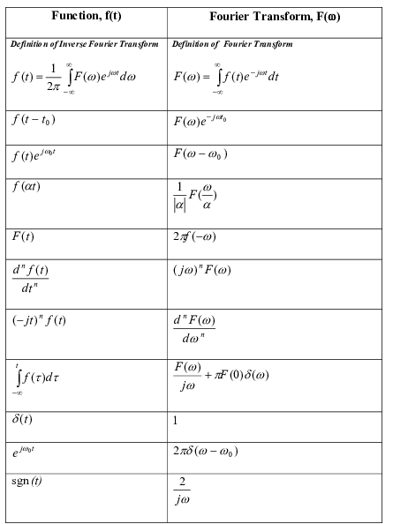
Traditional methods – Fourier
Decompose signals in frequency domain and describe our aiming function by the addition of several sines or cosines.
$$x\left(t\right) →X(f)$$

Slide 50
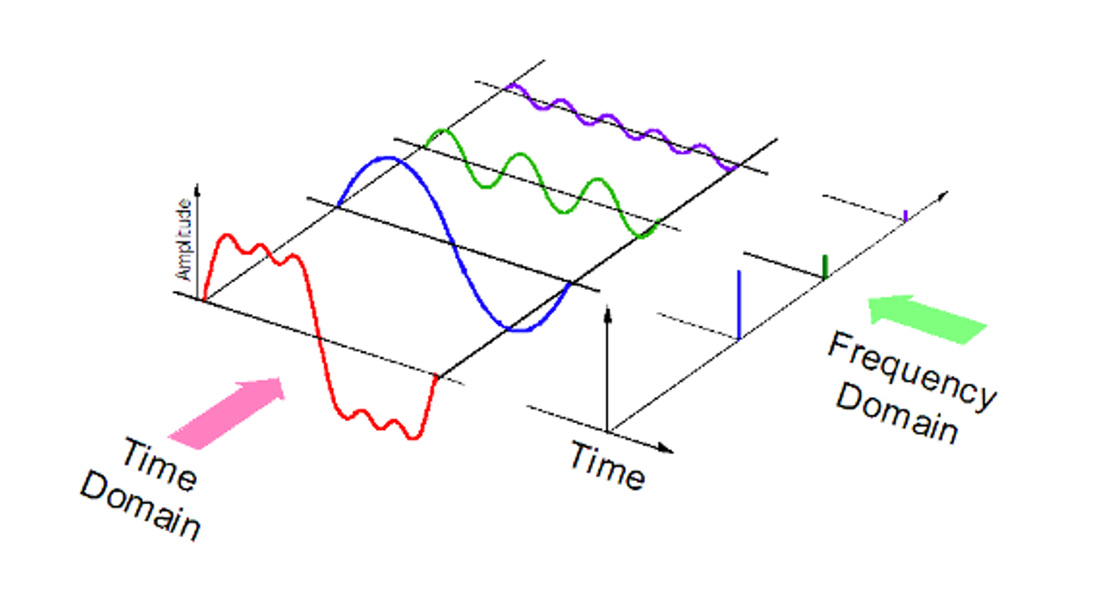
Traditional methods – Fourier
Decompose signals in frequency domain and describe our aiming function by the addition of several sines or cosines.
$$x\left(t\right) →X(f)$$

Slide 51


Slide 52
Fancy methods 1: Recurrent Neural Networks (RNN)

Slide 53
RNN (Recurrent Neural Networks)

Slide 54
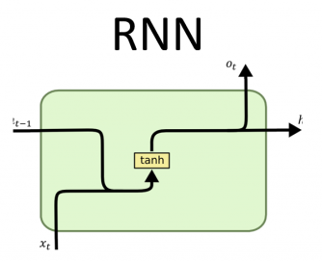
RNN (Recurrent Neural Networks)
Based on the connections of the nodes, this network type is able to work with temporal behavior based on Rumelhart’s work in 1986.
This network is commonly used for speech recognition, translation and many more applications.

Slide 55
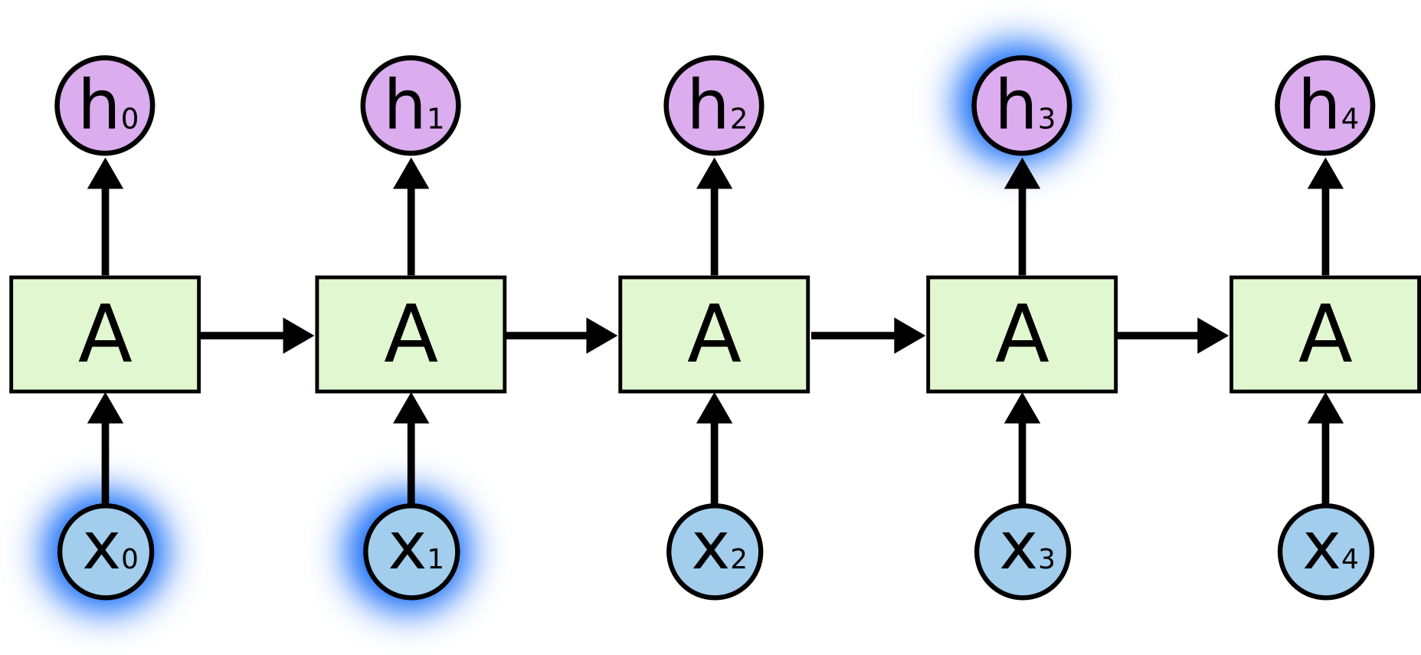
RNN (Recurrent Neural Networks)
Based on the connections of the nodes, this network type is able to work with temporal behavior based on Rumelhart’s work in 1986.
This network is commonly used for speech recognition, translation and many more applications, having problems with long-term dependencies problems but performing extremely good in those problems where the depencies are in short-term.

Slide 56
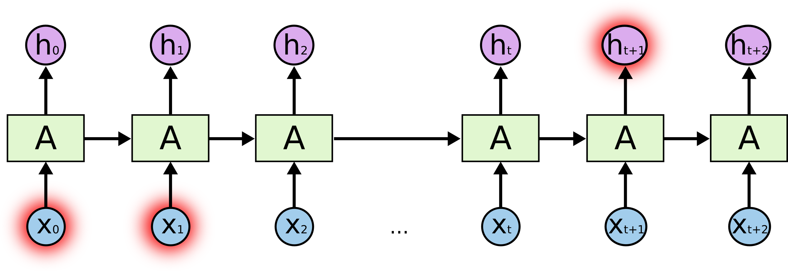
RNN (Recurrent Neural Networks)
Based on the connections of the nodes, this network type is able to work with temporal behavior based on Rumelhart’s work in 1986.
This network is commonly used for speech recognition, translation and many more applications, having problems with long-term dependencies problems but performing extremely good in those problems where the depencies are in short-term.

Slide 57
Fancy methods 1.5: Long Short Term Memory (LSTM)

Slide 58
LSTM (Long Short Term Memories)

Slide 59
LSTM (Long Short Term Memories)
Solves RNN problems of maintaining information in long-term dependencies, being useful for this long-term problems rather than the general RNN.

Slide 60
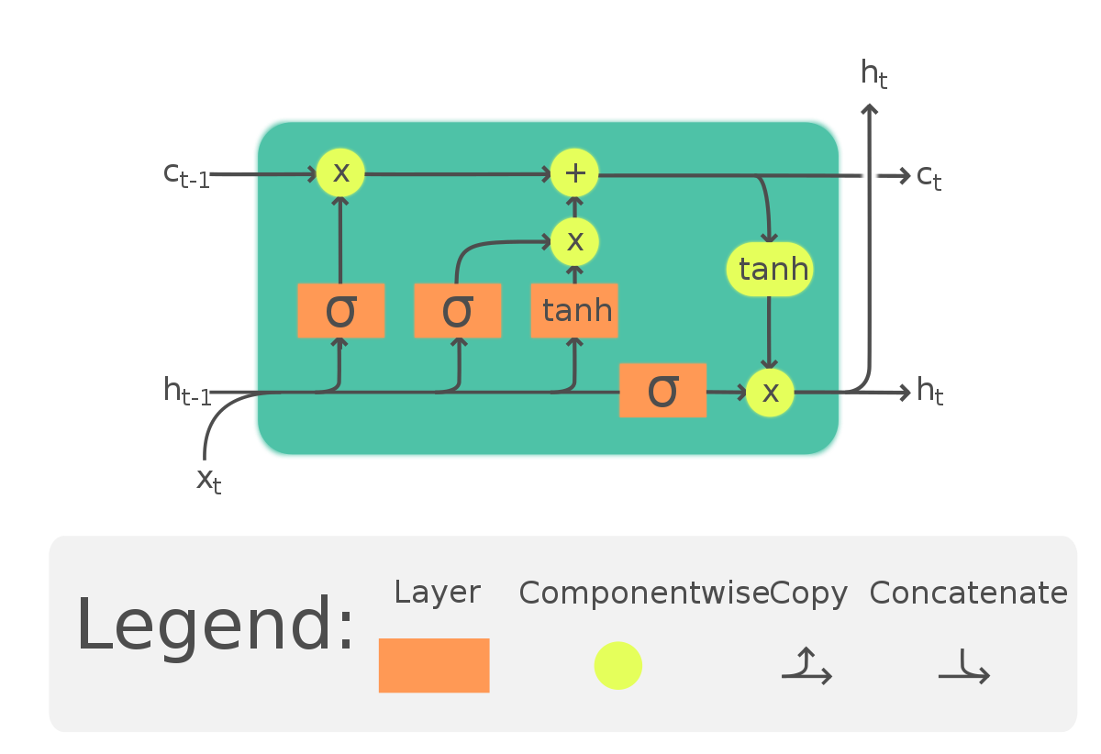
LSTM (Long Short Term Memories)
Solves RNN problems of maintaining information in long-term dependencies, being useful for this long-term problems rather than the general RNN.

Slide 61
LSTM (Long Short Term Memories)
Solves RNN problems of maintaining information in long-term dependencies, being useful for this long-term problems rather than the general RNN.
Inputs

Slide 62
LSTM (Long Short Term Memories)
Solves RNN problems of maintaining information in long-term dependencies, being useful for this long-term problems rather than the general RNN.
Outputs
Inputs

Slide 63
LSTM (Long Short Term Memories)
Solves RNN problems of maintaining information in long-term dependencies, being useful for this long-term problems rather than the general RNN.
Outputs
Inputs
Operation layers

Slide 64
LSTM (Long Short Term Memories)

Slide 65
LSTM (Long Short Term Memories)
Cell state

Slide 66
LSTM (Long Short Term Memories)
Cell state
Cell state: Holds the information, can be modified or not at each iteration.

Slide 67
LSTM (Long Short Term Memories)
Cell state
Cell current state
Cell state: Holds the information, can be modified or not at each iteration.

Slide 68
LSTM (Long Short Term Memories)
Cell state
Cell current state
Cell state: Holds the information, can be modified or not at each iteration.
Cell previous state

Slide 69
LSTM (Long Short Term Memories)
Cell state
Cell current state
Cell state: Holds the information, can be modified or not at each iteration.
Cell previous state
data processing

Slide 70
LSTM (Long Short Term Memories)
Cell state
Cell current state
Cell state: Holds the information, can be modified or not at each iteration.
Cell previous state
Previous output
data processing

Slide 71
LSTM (Long Short Term Memories)
Cell state
Cell current state
Cell state: Holds the information, can be modified or not at each iteration.
Cell previous state
Previous output
Current output
data processing

Slide 72
LSTM (Long Short Term Memories)
Cell state
Cell current state
Cell state: Holds the information, can be modified or not at each iteration.
Cell previous state
Previous output
Current output
Current input
data processing

Slide 73
LSTM – Step by step

Slide 74
LSTM – Step by step
1st stage: Actual vector is concatenated with the previous one and the sigmoid layer is applied before multiply it by the previous cell state.
In this stage we’re selecting which information is negligible from the cell state input.

Slide 75

LSTM – Step by step
1st stage: Actual vector is concatenated with the previous one and the sigmoid layer is applied before multiply it by the previous cell state.
In this stage we’re selecting which information is negligible from the cell state input.

Slide 76


LSTM – Step by step
2nd stage: The sigmoid processes which is the data that maximizes the information and the hyperbolic tangent provides candidates.
After mixing them, the output is added to the cell state, updating the information for this loop.

Slide 77



LSTM – Step by step
3rd stage: Cell state is done for this loop and is used as the input for the following neuron.
At the same time, the input is processed in another sigmoid layer.
Finally, this processes input and the cell state (after being computed with an hyperbolic tangent) is the output we’re looking for in this cell.

Slide 78
LSTM – Layers
As dense, and convolution, Long Short-Term Memory neurons are used as layers in any deep learning framework.
This time, the definition is way simpler than the previous layers we’ve seen:

Slide 79
LSTM – Layers
As dense, and convolution, Long Short-Term Memory neurons are used as layers in any deep learning framework.
This time, the definition is way simpler than the previous layers we’ve seen:
lstm = tf.keras.layers.LSTM(50)

Slide 80
LSTM – Layers
As dense, and convolution, Long Short-Term Memory neurons are used as layers in any deep learning framework.
This time, the definition is way simpler than the previous layers we’ve seen:
lstm = tf.keras.layers.LSTM(50)
Number of neurons

Slide 81
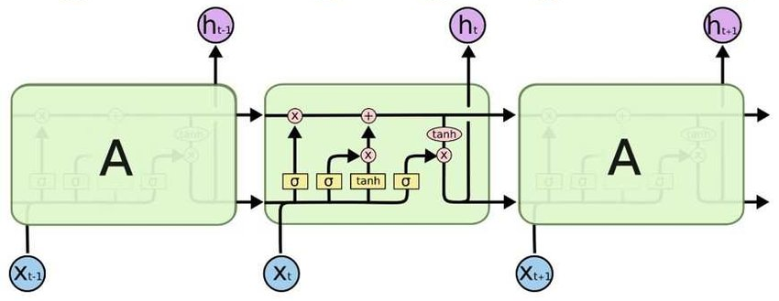
LSTM – Layers
As dense, and convolution, Long Short-Term Memory neurons are used as layers in any deep learning framework.
This time, the definition is way simpler than the previous layers we’ve seen:
lstm = tf.keras.layers.LSTM(50)
Number of neurons

Slide 82
LSTM – Example
For this examples, we’ll be using our vector from the 1D-CNN section (yesterday). If we perform the operation between the vector and the LSTM ends up in something like this:

Slide 83
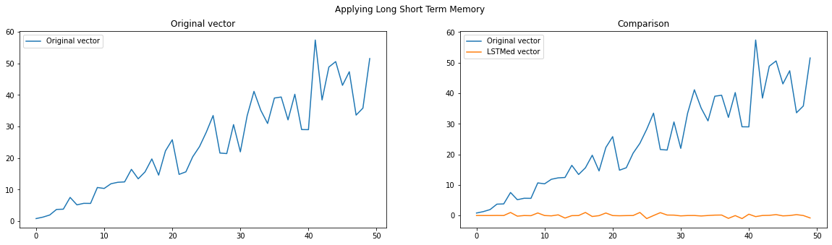
LSTM – Example
For this examples, we’ll be using our vector from the 1D-CNN section (yesterday). If we perform the operation between the vector and the LSTM ends up in something like this:

Slide 84
LSTM – Example
For this examples, we’ll be using our vector from the 1D-CNN section (yesterday). If we perform the operation between the vector and the LSTM ends up in something like this:

Slide 85
LSTM – Example
For this examples, we’ll be using our vector from the 1D-CNN section (yesterday). If we perform the operation between the vector and the LSTM ends up in something like this:

Slide 86
LSTM – Example
Is this everything?

Slide 87

LSTM – Example
Is this everything?

Slide 88
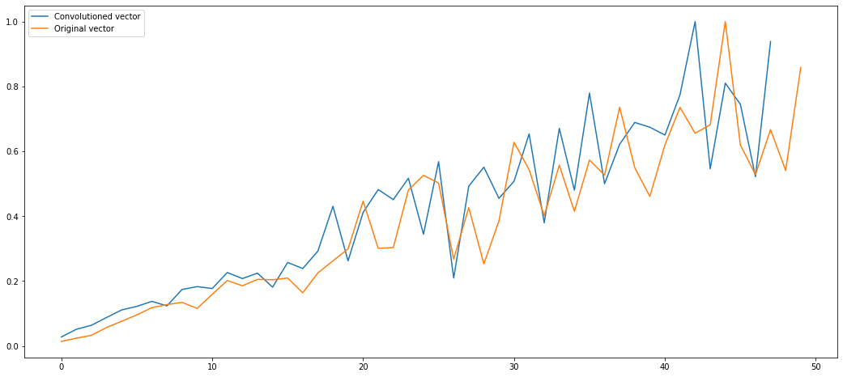
LSTM – Example
Is this a prediction?

Slide 89
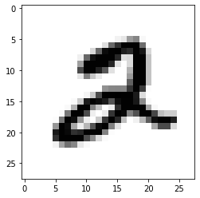
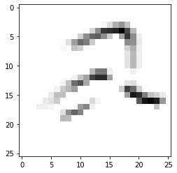
LSTM – Example
Is this a prediction?

Slide 90
LSTM – Example
This is happening because we only performed the operation. Same happened to convolution examples: Although we firstly performed convolution, we needed to use a model with a proper output to extract the knowledge from the data and get the results we were looking for.

Slide 91
LSTM – Example
This is happening because we only performed the operation. Same happened to convolution examples: Although we firstly performed convolution, we needed to use a model with a proper output to extract the knowledge from the data and get the results we were looking for.
Input cells

Slide 92
LSTM – Example
This is happening because we only performed the operation. Same happened to convolution examples: Although we firstly performed convolution, we needed to use a model with a proper output to extract the knowledge from the data and get the results we were looking for.
Input cells
Output cells

Slide 93
LSTM – Example
This is happening because we only performed the operation. Same happened to convolution examples: Although we firstly performed convolution, we needed to use a model with a proper output to extract the knowledge from the data and get the results we were looking for.
Input cells
Output cells
Memory cells we’ve seen today

Slide 94

LSTM – Example
This is happening because we only performed the operation. Same happened to convolution examples: Although we firstly performed convolution, we needed to use a model with a proper output to extract the knowledge from the data and get the results we were looking for.
Flatten !
Input cells
Output cells
Memory cells we’ve seen today

Slide 95
LSTM – Example
This is happening because we only performed the operation. Same happened to convolution examples: Although we firstly performed convolution, we needed to use a model with a proper output to extract the knowledge from the data and get the results we were looking for.
Flatten !
Input cells
Output cells
Memory cells we’ve seen today

Slide 96
LSTM – Example
To tackle this, is as simple as add a single Dense layer that will be considered as our output since we’re looking for predict the following value.

Slide 97
LSTM – Example
To tackle this, is as simple as add a single Dense layer that will be considered as our output since we’re looking for predict the following value.
model = models.Sequential()
model.add(tf.keras.layers.LSTM(50, input_shape=(50, 1)))
model.add(tf.keras.layers.Dense(1))

Slide 98
LSTM – Example
To tackle this, is as simple as add a single Dense layer that will be considered as our output since we’re looking for predict the following value.
model = models.Sequential()
model.add(tf.keras.layers.LSTM(50, input_shape=(50, 1)))
model.add(tf.keras.layers.Dense(1))
Are we ready to predict?

Slide 99

LSTM – Example
To tackle this, is as simple as add a single Dense layer that will be considered as our output since we’re looking for predict the following value.
model = models.Sequential()
model.add(tf.keras.layers.LSTM(50, input_shape=(50, 1)))
model.add(tf.keras.layers.Dense(1))
Are we ready to predict?

Slide 100
LSTM – Example
To tackle this, is as simple as add a single Dense layer that will be considered as our output since we’re looking for predict the following value.
model = models.Sequential()
model.add(tf.keras.layers.LSTM(50, input_shape=(50, 1)))
model.add(tf.keras.layers.Dense(1))
As any other model, optimizer and compilation are required, but this time the compile is slightly different: Since we’re not classifying, the loss function has to be one of the regression losses from TensorFlow package.

Slide 101
LSTM – Example
To tackle this, is as simple as add a single Dense layer that will be considered as our output since we’re looking for predict the following value.
model = models.Sequential()
model.add(tf.keras.layers.LSTM(50, input_shape=(50, 1)))
model.add(tf.keras.layers.Dense(1))
As any other model, optimizer and compilation are required, but this time the compile is slightly different: Since we’re not classifying, the loss function has to be one of the regression losses from TensorFlow package.
opt = tf.keras.optimizers.SGD(learning_rate=0.001, momentum=0.9)
model.compile(optimizer=opt, loss='mse')

Slide 102
LSTM – Example
To tackle this, is as simple as add a single Dense layer that will be considered as our output since we’re looking for predict the following value.
model = models.Sequential()
model.add(tf.keras.layers.LSTM(50, input_shape=(50, 1)))
model.add(tf.keras.layers.Dense(1))
As any other model, optimizer and compilation are required, but this time the compile is slightly different: Since we’re not classifying, the loss function has to be one of the regression losses from TensorFlow package.
opt = tf.keras.optimizers.SGD(learning_rate=0.001, momentum=0.9)
model.compile(optimizer=opt, loss='mse')
https://keras.io/api/losses/regression_losses/

Slide 103

Coffee break

Slide 104
Fancy methods 2: 1D Convolutions

Slide 105
1D Convolutions
Since 1D convolutions output are quite similar to LSTM, we can use them too to perform forecasting.
As said before, this is only the process, but the knowledge is still missing!

Slide 106
1D Convolutions
To tackle this problem, adding a dense structure (sounds familiar) is enough to extract the knowledge for predictions.

Slide 107
1D Convolutions
To tackle this problem, adding a dense structure (sounds familiar) is enough to extract the knowledge for predictions.
model = models.Sequential()
model.add(tf.keras.layers.Conv1D(filters=1,
kernel_size=3,
input_shape=(50, 1)))
model.add(tf.keras.layers.Flatten())
model.add(tf.keras.layers.Dense(1))
model.compile(optimizer='sgd', loss='mse')

Slide 108
1D Convolutions
To tackle this problem, adding a dense structure (sounds familiar) is enough to extract the knowledge for predictions.
model = models.Sequential()
model.add(tf.keras.layers.Conv1D(filters=1,
kernel_size=3,
input_shape=(50, 1)))
model.add(tf.keras.layers.Flatten())
model.add(tf.keras.layers.Dense(1))
model.compile(optimizer='sgd', loss='mse')
Vectorize to fit dense section

Slide 109
1D Convolutions
To tackle this problem, adding a dense structure (sounds familiar) is enough to extract the knowledge for predictions.
model = models.Sequential()
model.add(tf.keras.layers.Conv1D(filters=1,
kernel_size=3,
input_shape=(50, 1)))
model.add(tf.keras.layers.Flatten())
model.add(tf.keras.layers.Dense(1))
model.compile(optimizer='sgd', loss='mse')
Vectorize to fit dense section

Slide 110
1D Convolutions
To tackle this problem, adding a dense structure (sounds familiar) is enough to extract the knowledge for predictions.
model = models.Sequential()
model.add(tf.keras.layers.Conv1D(filters=1,
kernel_size=3,
input_shape=(50, 1)))
model.add(tf.keras.layers.Flatten())
model.add(tf.keras.layers.Dense(1))
model.compile(optimizer='sgd', loss='mse')
Vectorize to fit dense section
Our dense layer (output too)

Slide 111
1D Convolutions
To tackle this problem, adding a dense structure (sounds familiar) is enough to extract the knowledge for predictions.
model = models.Sequential()
model.add(tf.keras.layers.Conv1D(filters=1,
kernel_size=3,
input_shape=(50, 1)))
model.add(tf.keras.layers.Flatten())
model.add(tf.keras.layers.Dense(1))
model.compile(optimizer='sgd', loss='mse')
Vectorize to fit dense section
Our dense layer (output too)
https://keras.io/api/losses/regression_losses/

Slide 112
1D Convolutions
To tackle this problem, adding a dense structure (sounds familiar) is enough to extract the knowledge for predictions.
model = models.Sequential()
model.add(tf.keras.layers.Conv1D(filters=1,
kernel_size=3,
input_shape=(50, 1)))
model.add(tf.keras.layers.Flatten())
model.add(tf.keras.layers.Dense(1))
model.compile(optimizer='sgd', loss='mse')
Vectorize to fit dense section
Our dense layer (output too)
https://keras.io/api/losses/regression_losses/

Slide 113
1D Convolutions
To tackle this problem, adding a dense structure (sounds familiar) is enough to extract the knowledge for predictions.
model = models.Sequential()
model.add(tf.keras.layers.Conv1D(filters=1,
kernel_size=3,
input_shape=(50, 1)))
model.add(tf.keras.layers.Flatten())
model.add(tf.keras.layers.Dense(1))
model.compile(optimizer='sgd', loss='mse')
Vectorize to fit dense section
Our dense layer (output too)
There’s no activation function since the prediction does not have a range to be limited by an activation function.
https://keras.io/api/losses/regression_losses/

Slide 114
1D Convolutions
Necessary to process the data:
- Define how many 'past sample' we want to use (X)
- Define which value should be (Y) based on the data we have.

Slide 115
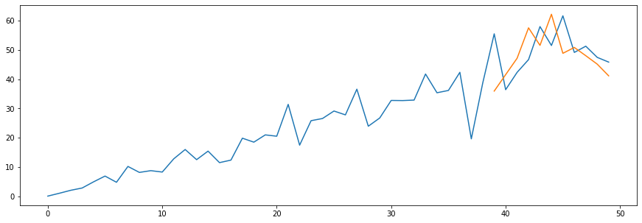
Warning!

Slide 116
Warning!
Be careful to not overfit the model!

Slide 117
Fancy methods application: Outlier detection

Slide 118
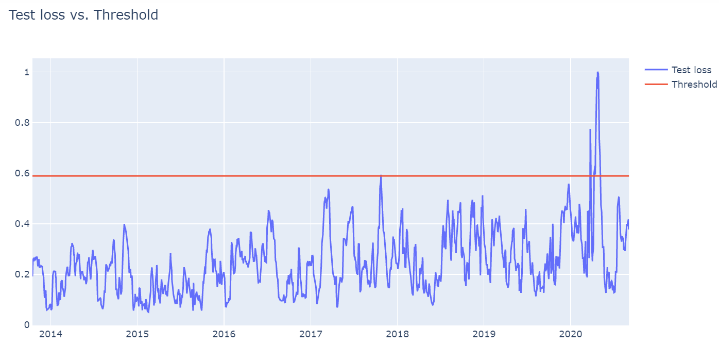
Outlier detection
Up until now we’ve seen all the stuff focused mainly on forecasting, but this is not the only usage of this methods (although is commonly used).
Anomaly detection using mainly LSTM (1D CNN also suits) is another application for time-series problems such as biomedical signals (ecg, emg …)
Outlier region

Slide 119
Outlier detection
To determine anomalies in our time series model we have to:
Find the MAE (Mean Absolute Error) on the training data.
Get the maximum error and use it as a threshold.
If a loss surpasses this threshold, this data is considered an anomaly.
X_train_pred = model.predict(X_train, verbose=0)
train_mae_loss = np.abs(X_train_pred – X_train)
threshold = np.max(train_mae_loss)

Slide 120


Deliverable + Hands on!
Day-3 Sequential notebooks

Slide 121
Thanks
Do you have any questions?
Sergi.bernet@salle.url.edu

